Slide 1

Automation Recipes: DM with RPA
Nigel T. Crowther
Automation Tech Sales EMEA
IBM
ncrowther@uk.ibm.com
IBM Robotic Process Automation
Try it now: https://www.ibm.com/account/reg/ca-en/signup?formid=urx-46597

Slide 2
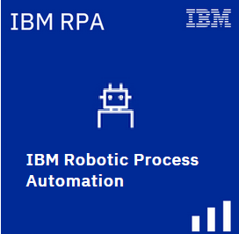


IBM Decision Manager Open Edition and IBM RPA
RPA is bundled FREE with DM and PAM
Limited to one unattended bot.
This is enough in many cases!
IBM Process Automation Manager Open Edition
IBM Decision Manager
Open Edition
Process Automation and Decision Automation
Decision Automation
Notes:
IBM Process Automation Manager Open Edition and IBM Decision Manager Open Edition are fully open-source application development platforms that help clients build highly-customized and scalable cloud-native business automation applications. Clients use Process Automation Manager to model and automate their business processes, including decision automation. They use Decision Manager to focus on decision modeling and automation. Both allow for the rapid development and maintenance of intelligent business automation applications and processes.

Slide 3
Why DM and IBM RPA?
RPA Bots automate drudgery
Drudgery requires decisions!
DM cost effective for small decision services
Low(ish) footprint
Notes:
IBM Process Automation Manager Open Edition and IBM Decision Manager Open Edition are fully open-source application development platforms that help clients build highly-customized and scalable cloud-native business automation applications. Clients use Process Automation Manager to model and automate their business processes, including decision automation. They use Decision Manager to focus on decision modeling and automation. Both allow for the rapid development and maintenance of intelligent business automation applications and processes.

Slide 4
What is RPA?
RPA is a scripting language
RPA automates the good, the bad and the ugly
RPA is low cost and fast ROI

Slide 5






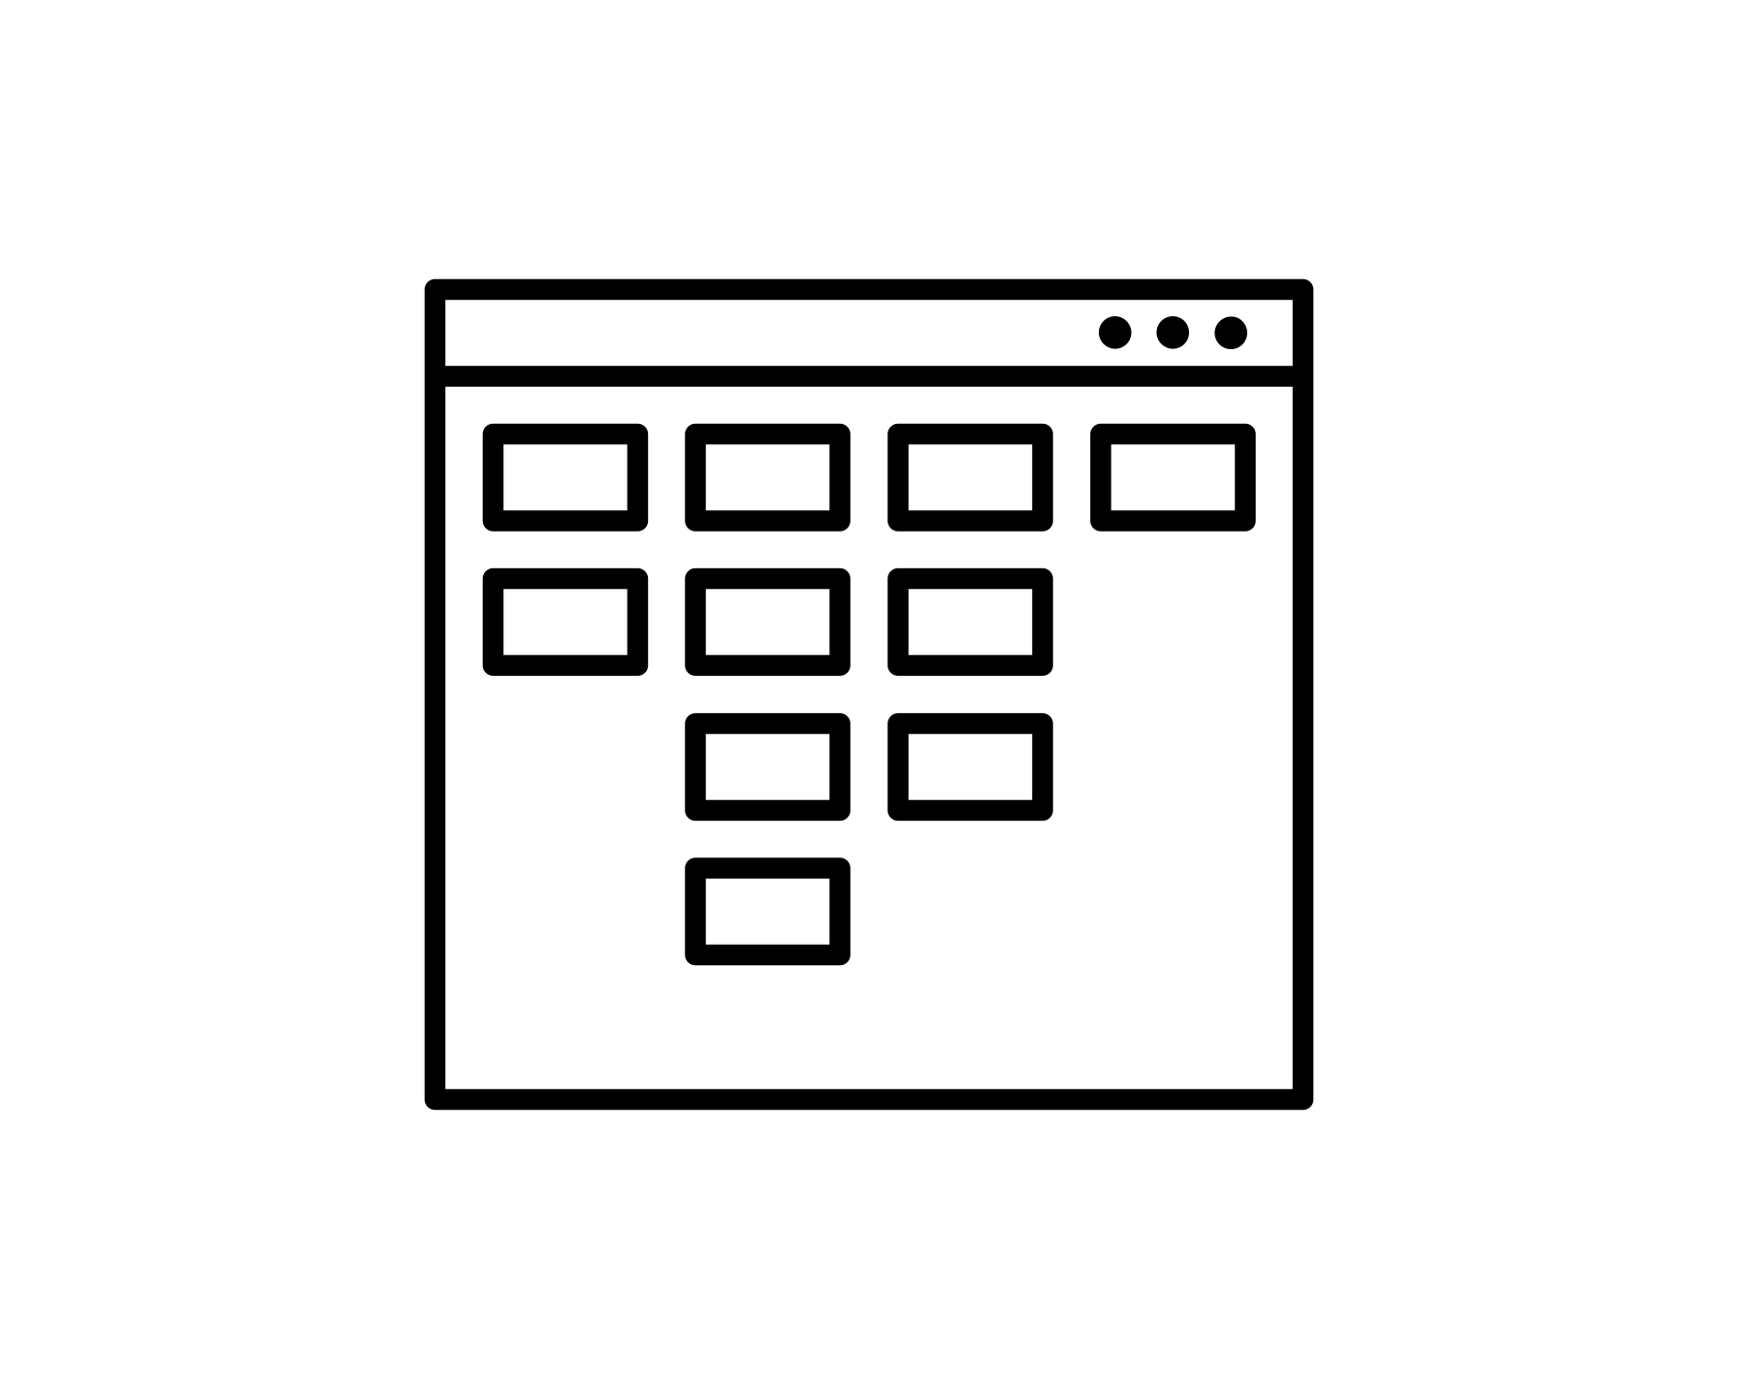


What can bots do?
Use Microsoft Windows
Use file system, clipboard, taskbar, services, open and close applications
Use desktop applications
Work with web apps, Windows apps, Microsoft Office suite, SAP, Java apps, remote desktop
Interact with systems
Access mainframes, call APIs, update and query databases
Communicate
Send and read emails and SMS messages, chat using text and voice
Read documents
Extract structured data from unstructured content
Apply intelligence
Understand information, make decisions, apply knowledge, learn
Create documents
PDF Reports, MS Excel, MS Word
Process Data
Encrypt, analyze, perform calculations
Process Files
Create, upload/download, transfer
Notes:
Robot Process Automation (RPA) is used to automate tasks that are traditionally performed by people, by mimicking the steps that a person would take when performing activities on their desktop computer.
For example, a software robot (or bot) can be created to gather data from multiple systems, collate the data within a spreadsheet, perform some calculations, and enter the data into another system by using the application user interfaces in exactly the same way a person would do it. Bots can also use traditional techniques to integrate with systems, like SQL to query a database or JSON/HTTP to call a REST service.
Other examples include:
Use Microsoft Windows OS - Use file system, clipboard, taskbar, services, open and close applications
Use desktop applications - Work with web apps, Windows apps, Microsoft Office suite, SAP, Java apps, remote desktop
Interact with systems - Access mainframes, call APIs, update and query databases
Communicate - Send and read emails and SMS messages, chat using text and voice
Read documents - Extract structured data from unstructured content
Apply intelligence - Understand information, make decisions, apply knowledge, learn
Create documents - PDF Reports, MS Excel, MS Word
Process Data - Encrypt, analyze, perform calculations
Process Files - Create, upload/download, transfer

Slide 6


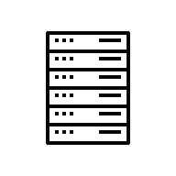




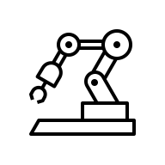
RPA use cases by industry
Banking and insurance
Onboarding
Insurance claims tasks
Loan origination
Energy and utilities
Data collection and reporting
Contracts
Regulations and compliance
IT
Data entry
Capture
Mass email management
Reporting
Data synchronization
Travel and transportation
Payroll
Vehicle checks and reporting
Healthcare
Medical Appointments
Medical bills
Medical claims tasks
Media and communications
Order management
Provisioning
Government
Benefits processing
Eligibility
Self service updates
Retail industry
Refunds
Procurement
Price comparison
Invoice processing

Slide 7



Example – Invoice Processing for Coop Midcounties
Finance system reads XML invoice and processes it
Start
Invoice Received by Email
Determine invoice type
OCR invoice and write to XML
End
Process Automation and Decision Automation
XML Invoices
IBM Decision Manager
Open Edition

Slide 8
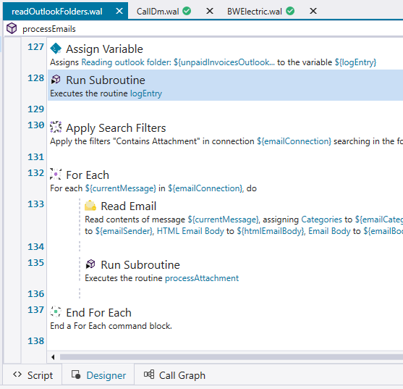
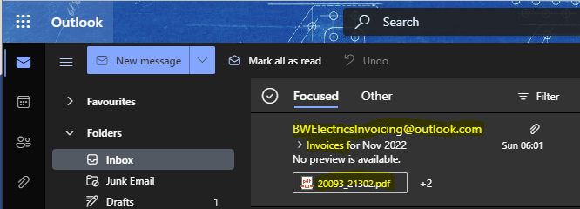
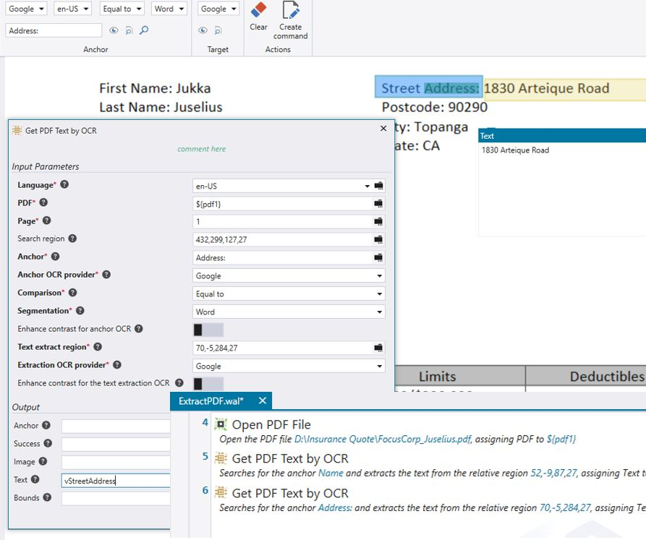

The Email The bot reads emails containing invoices and lets DM decide on how to process them…

Slide 9
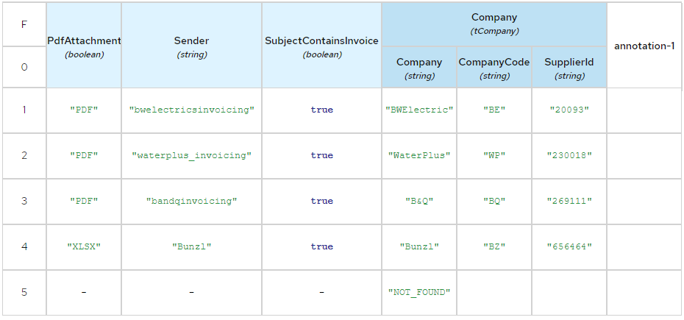
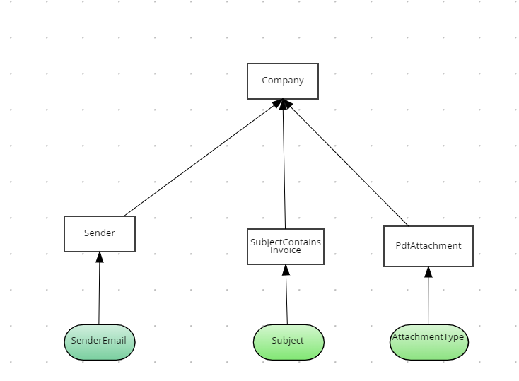
The Rules DM looks at email header to determine how to process the invoice
IBM Decision Manager
Open Edition

Slide 10
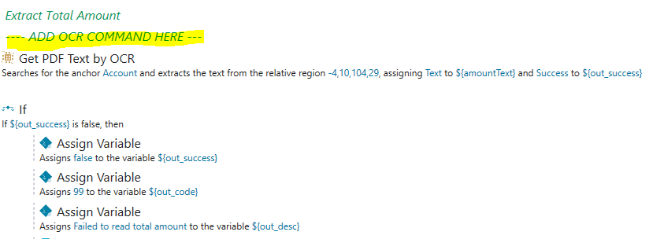
The OCR The bot OCRs the invoices identified by DM and writes the result to an XML file

Slide 11
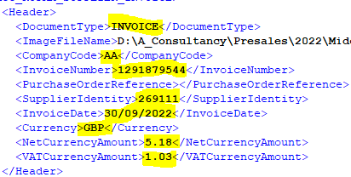
The XML The bot writes the result to an XML file

Slide 12
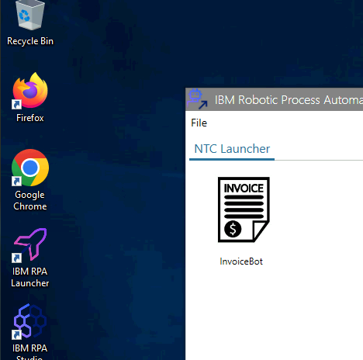
Git Repo:
https://github.com/ncrowther/InvoiceApproval

